Slide 1







James Bedford
(Former) PQIP fellow
Consultant in Anaesthesia and Perioperative Medicine
University College London Hospitals NHS Trust
@jbedford84

Slide 2
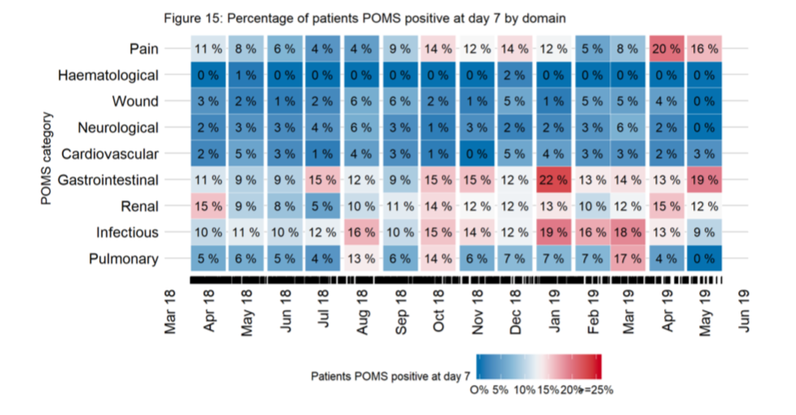
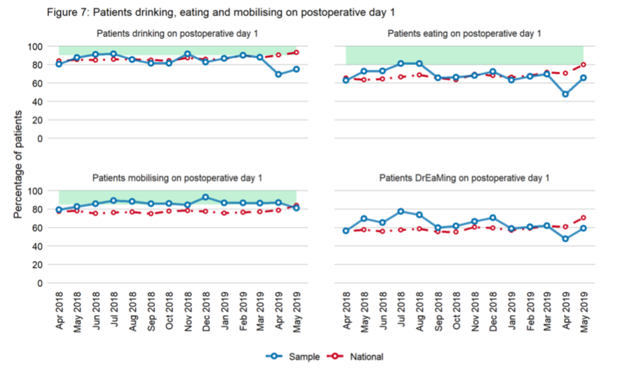
Outcome reporting
Focus on continuous reporting within PQIP
Notes:
Continuous reporting of data – to see trend over time, but not risk adjusted currently
Therefore – hospitals caring for higher risk patients may ’appear’ to have worse outcomes

Slide 3
Cross-sectional risk-adjusted analyses
Notes:
Traditional cross sectional analyses use funnel plots – showing standardized mortality rates
However, condense down often a year’s worth of cases to single point. No trend over time

Slide 4
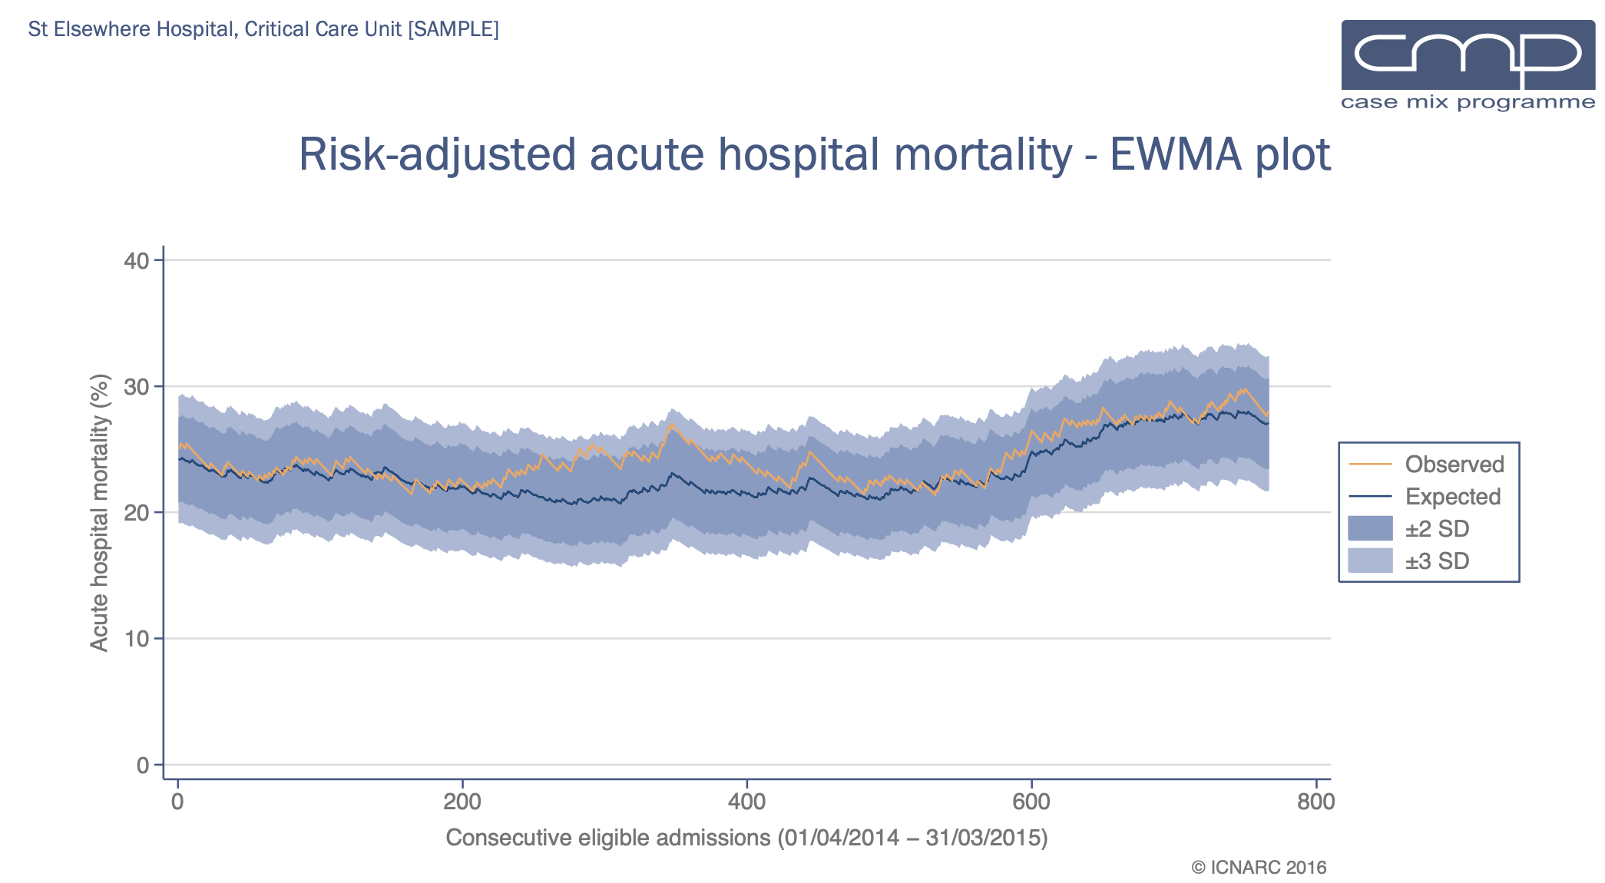
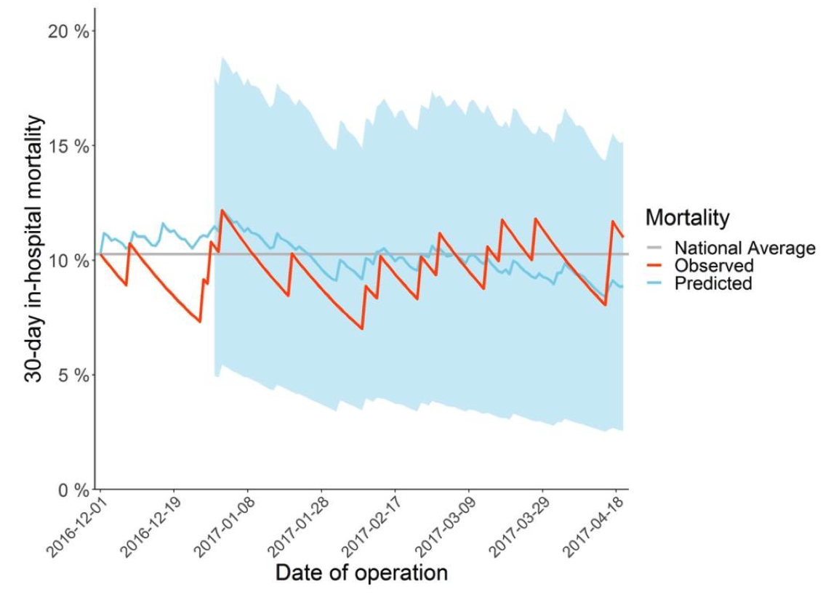
Continuous risk adjusted
monitoring
Exponentially weighted moving average chart (EWMA)
Notes:
Some national projects have started to use continuous methods – such as EWMA – here ICNARC and NELA have adopted these
Explain ICNARC plot:

Slide 5
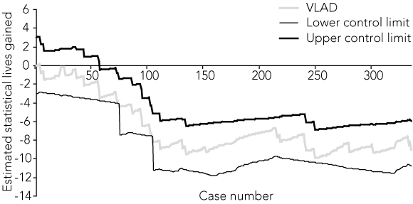
Continuous risk adjusted
monitoring
Variable life-adjusted display (VLAD)
Also: Risk-adjusted cumulative sum charts (RA-CUSUM)
Notes:
Another method is the VLAD – plots expected minus observed. Upward trends are positive, downward negative
Traditionally do not include control limits but these can be added using a variety of different methods.

Slide 6
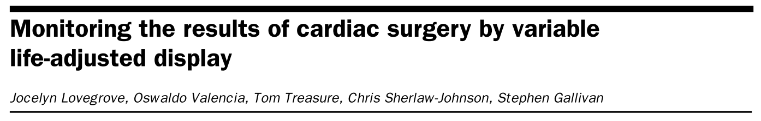
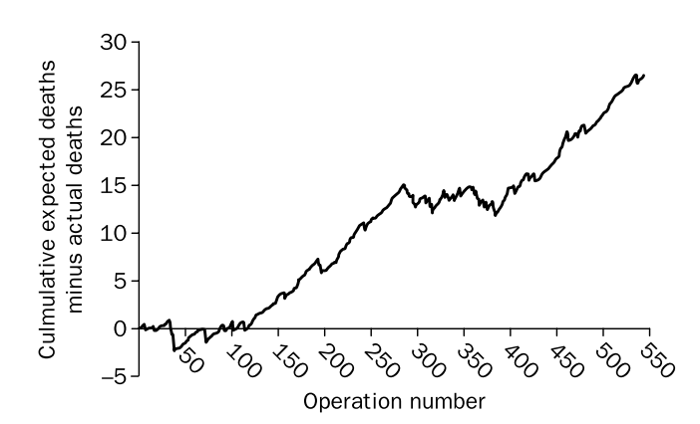
Variable life-adjusted display (VLAD)
Originally developed to show expected minus observed deaths over time
But can be used for any binary outcome

Slide 7
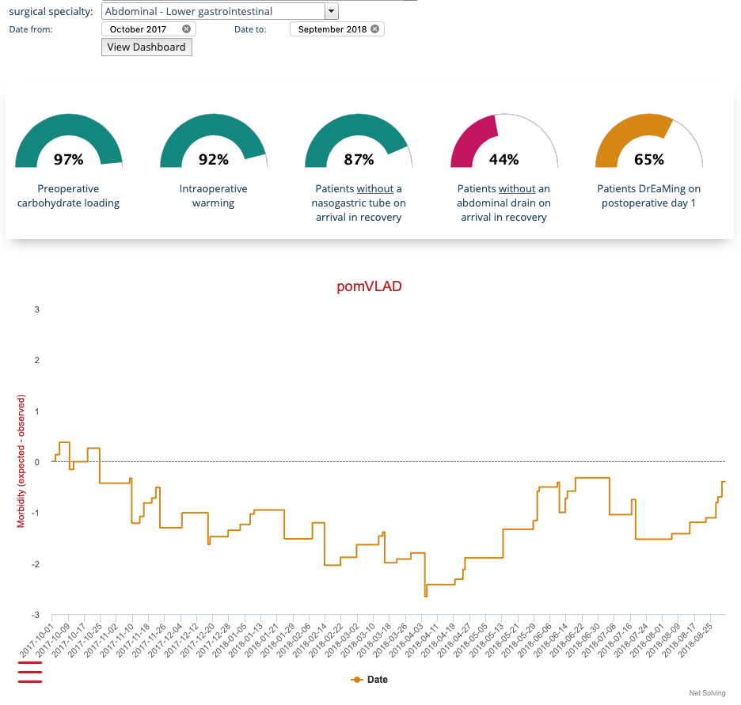

v1.0
Postoperative morbidity and key ERAS measures
Implemented into 10 pilot sites in May 2018
Mixed-methods evaluation (20 sites in total)

Slide 8
Findings from
pilot study
Qualitative findings:
VLAD provided an opportunity to engage surgical colleagues in QI work
Intuitive, easy to understand (after initial learning curve)
Morbidity was useful outcome measure to report – more relevant than mortality
Range of morbidity/complications outcomes reported in PQIP could be confusing
Useful for M&M and audit purposes
pomVLAD helpful for providing quick overview of care delivery
Notes:
Quantitative findings: No statistical difference between control and intervention groups for risk-adjusted postoperative morbidity
For process measures – again no statistically significant differences across process measures (after adjusting for multiple testing) but time-period perhaps too short to observe changes. Qual work also demonstrated difficulty in delivering QI locally due to time constraints, limited financial support to implement change
Underlined are examples of where collaborators who took part in the interviews have shaped the development of pomVLAD – we have changed elements of the pilot version based on their feedback and experience

Slide 9
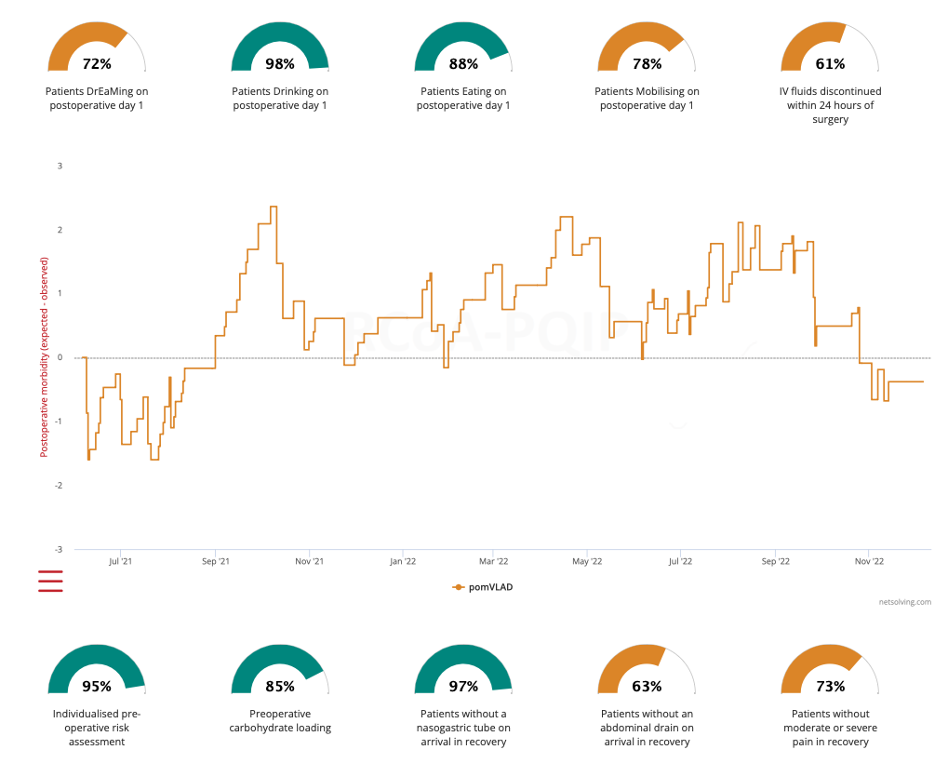
v2.0
What’s new:
Updated risk-adjustment model
All POMS defined morbidity (not just POMS-major)
Additional targeted ERAS process measures to support QI work

Slide 10
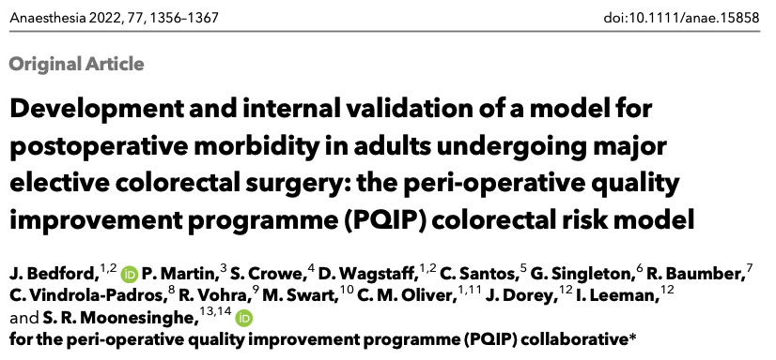
Risk-adjustment for pomVLAD
https://github.com/jbedford1984/PQIP-CR-model-development

Slide 11
Ten variables included in risk-adjustment model:
Mode of surgery (laparoscopic/robotic/open)
Rockwood Clinical Frailty Scale
Sex
Severity of surgery (Minor/Intermediate/Major/Xmajor/Complex)
ASA
BMI
Age
Index of Multiple Deprivation quintile
Blood tests: Sodium, Urea, Creatinine, White Cell Count
Missing variables will be imputed - using lowest risk input
Risk-adjustment for pomVLAD

Slide 12
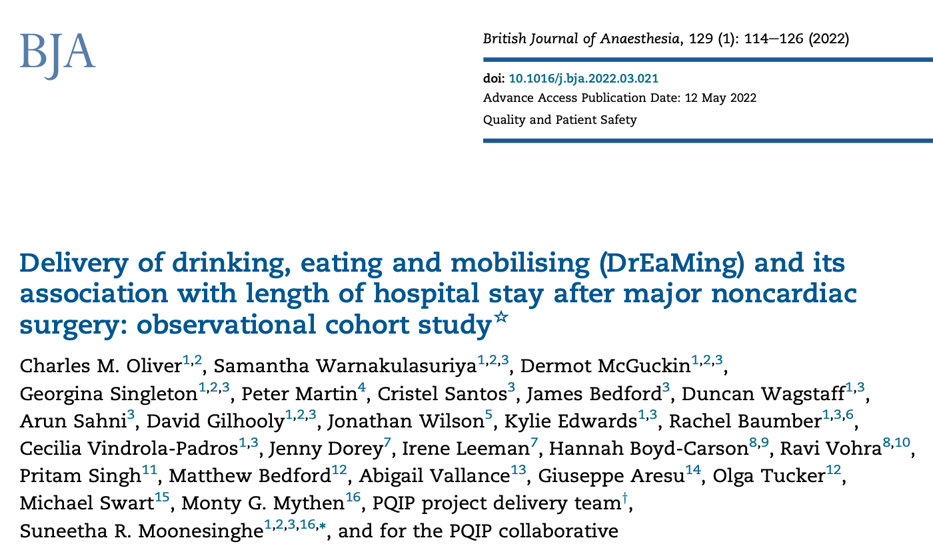
Enhanced recovery measures
Based on published PQIP data analysing the association between DrEaMing (and other process measures) and prolonged postoperative length of stay

Slide 13
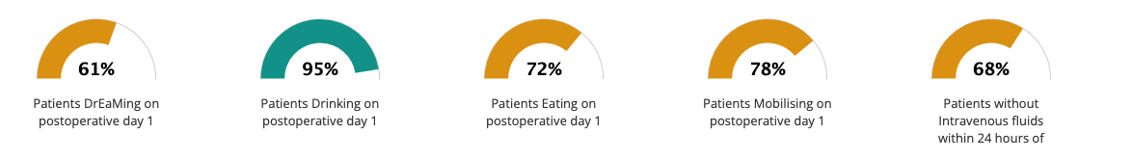
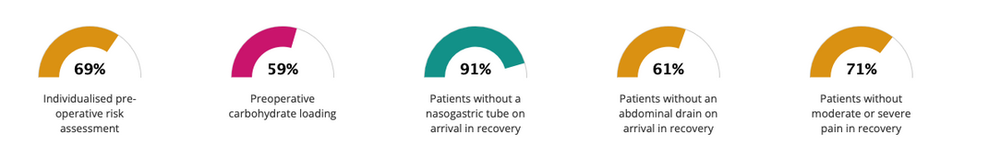
Enhanced recovery measures

Slide 14
Using
Suggest having at least 12 months in view
Dials display performance for time period selected – offer targets for QI
Hovering over the chart will show caseIDs to support M&M and QI work
Inpatient deaths are flagged by red triangle on the chart

Slide 15
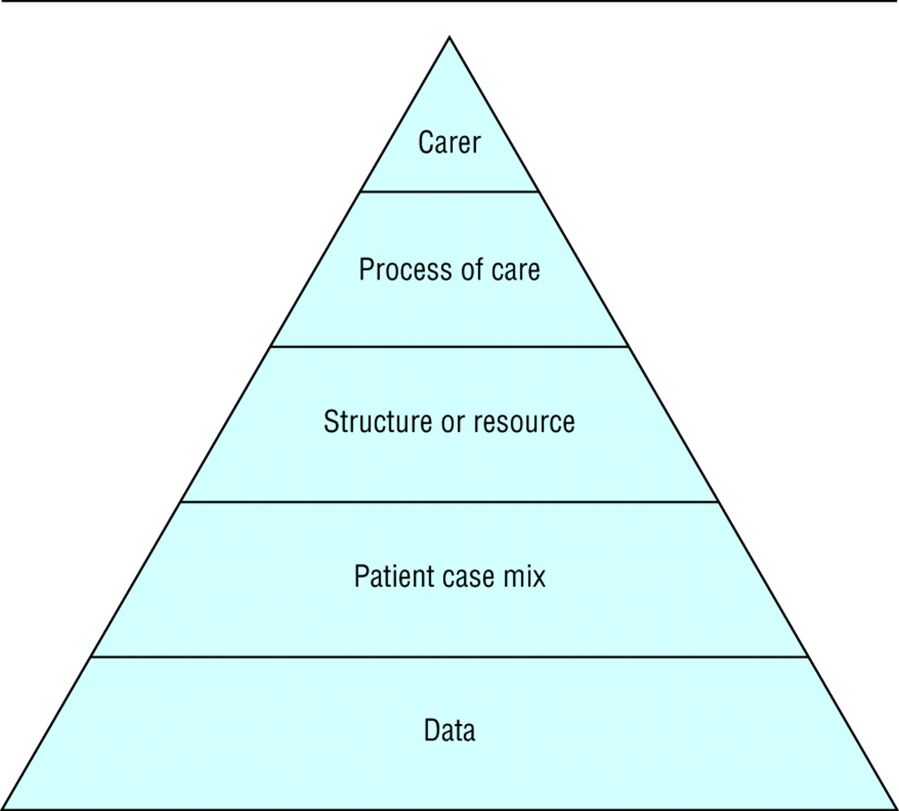
Monitoring tools do not provide the definitive answer…
The pyramid model supports local investigation of outcomes
Consistent trends (good or bad) indicate the need for further investigation to improve understanding – starting at the bottom of the pyramid
Mohammed M A, Rathbone A, Myers P, Patel D, Onions H, Stevens A et al. An investigation into general practitioners associated with high patient mortality flagged up through the Shipman inquiry: retrospective analysis of routine data BMJ 2004; 328 :1474 doi:10.1136/bmj.328.7454.1474

Slide 16
Thank you to all those collaborators who took part in the pomVLAD pilot study
Your time, thoughts and feedback have supported this work
Q & A
@jbedford84
James.bedford1@nhs.net

