Slide 1






PQIP update
Ramani Moonesinghe
PQIP Chief Investigator
Director, Health Services Research Centre, Royal College of Anaesthetists
Professor of Perioperative Medicine, UCL
National Clinical Director for Critical and Perioperative Care, NHS England and NHS Improvement

Slide 2
What a year…..

Slide 3
Plan for the next 45m – with time for Q&A
Update on the programme overall
Protocol amendments
Annual report 2021 and HSRC conference
Publication policy
Analysis and publication plans
Future of PQIP:
  Clinical trials platform
  Focusing on QI component
    Rethinking the dashboards
    POM-VLAD wider roll-out
  Considering how we try to do everything….?!

Slide 4
Update on the programme overall
Almost 32,000 patients recruited
Locked records: just over 28,000
Specialty | Number | Percentage
Abdominal - Lower gastrointestinal | 12282 | 43.66
Urology | 4212 | 14.97
Thoracics | 2547 | 9.05
Abdominal - Hepatobiliary | 2198 | 7.81
Abdominal - Upper gastrointestinal | 1935 | 6.88
Orthopaedics | 1387 | 4.93
Abdominal - other | 845 | 3.00
Spinal | 781 | 2.78
Head and neck | 633 | 2.25
Burns and Plastics | 567 | 2.02
Gynaecology | 517 | 1.84
Vascular | 217 | 0.77
Not recorded | 9 | 0.03

Slide 5
Helping you to help PQIP – protocol and dataset changes
Aims:
  Make consent COVID-19 safe and easier to deliver
  Review all data items and trim unnecessary items from the dataset (reduce data collection burden)

Slide 6
Changes
Protocol
Dataset
Remote consent
Including patients receiving NHS treatment in independent sector hospitals
Main dataset:
  several questions removed
  COVID questions added
Patient dataset –
  QOR questionnaire removed (baseline and D3)
  Some additional questions on ethnicity and financial status

Slide 7
Annual report and HSRC conference
Annual report will cover:
  Aug 2019 – 1 March 2020
  Since March 2020
Online only
No collaborative event but…
  Online HSRC conference - 9 September
  Cheap with some additional discounts!
  Combination of presentations and discussion panels with senior NHS leaders

Slide 8
Publication policy
Authorship:
  Fulfil ICJME criteria
Citable collaborators:
  Local PIs
  Key local investigators
  Will be Pubmed searchable
Non-citable collaborators:
  Everyone else
  Up to date list maintained on PQIP website

Slide 9
Publications….exciting!
Does PQIP work?! And if it does…how / why?!
Trends in process over the duration of the programme
Can we redefine Enhanced recovery?
  Does DrEaMing ‘work’?
Is the PQIP sample representative of the total PQIP potential population?
How do hospitals with good engagement / compliance with quality measures achieve their results?
Predicting risk of more patient-centred outcomes (e.g. Days Alive and Out of Hospital)
How do ethnicity and socioeconomic status impact on perioperative outcomes?

Slide 10
Our continued promise to you…
No funnel plots
No naming and shaming
Only celebrating successes

Slide 11


The future of PQIP…platform for clinical trials?

Slide 12
VITAL – Volatile vs. Intravenous Anaesthesia
Chief Investigator: Joyce Yeung
Collaboration with Warwick Clinical Trials unit and POM-CTN
40 hospitals
PQIP providing data platform
Patients will be able to consent to:
  PQIP only
  PQIP + VITAL

Slide 13
Your opportunity to collaborate?
Suggest an analysis for the central team to undertake
Put in an application to access data:
  We will publish a list of ongoing and planned analysis
Suggest a clinical trial

Slide 14
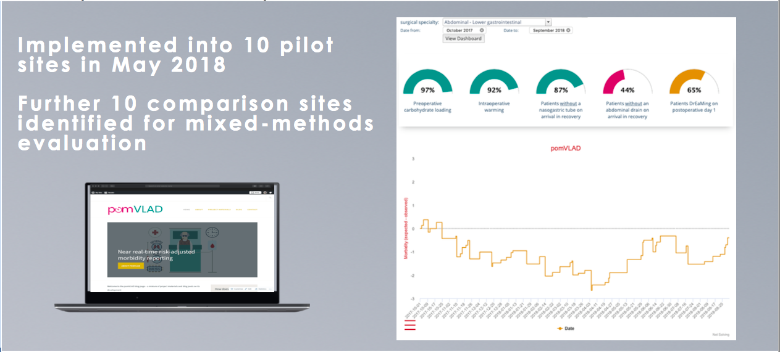
Focus on QI
Led by James Bedford and supported by the Health Foundation Innovating for Improvement programme

Slide 15
Summary
Exciting times ahead we hope
We really need you!!
Very keen to understand your challenges and help overcome them if we can
Thank you so much for everything you have done:
  For PQIP
  For the NHS
  For each other

Slide 16
Q&A time
Ramani.moonesinghe@nhs.net
pqip@rcoa.ac.uk

